Slide 1
Skincare Perception
Meghna Suraj Kashyap | msurajka
Shivam Yadav | shivamy
Vishal Chatterjee | vchatter

Slide 2
Business Question
How does the use of scientific language versus emotionally-driven language in skincare product descriptions impact consumer interest and purchase intent?

Slide 3
Specific Hypothesis
Product: La Roche-Posay, Toleriane Double Repair Face Moisturizer
Product descriptions using emotionally-driven language will result in higher likelihood of purchase and higher emotional appeal in consumers.
Product descriptions using scientific language will enhance perceptions of trustworthiness and the product’s effectiveness.

Slide 4
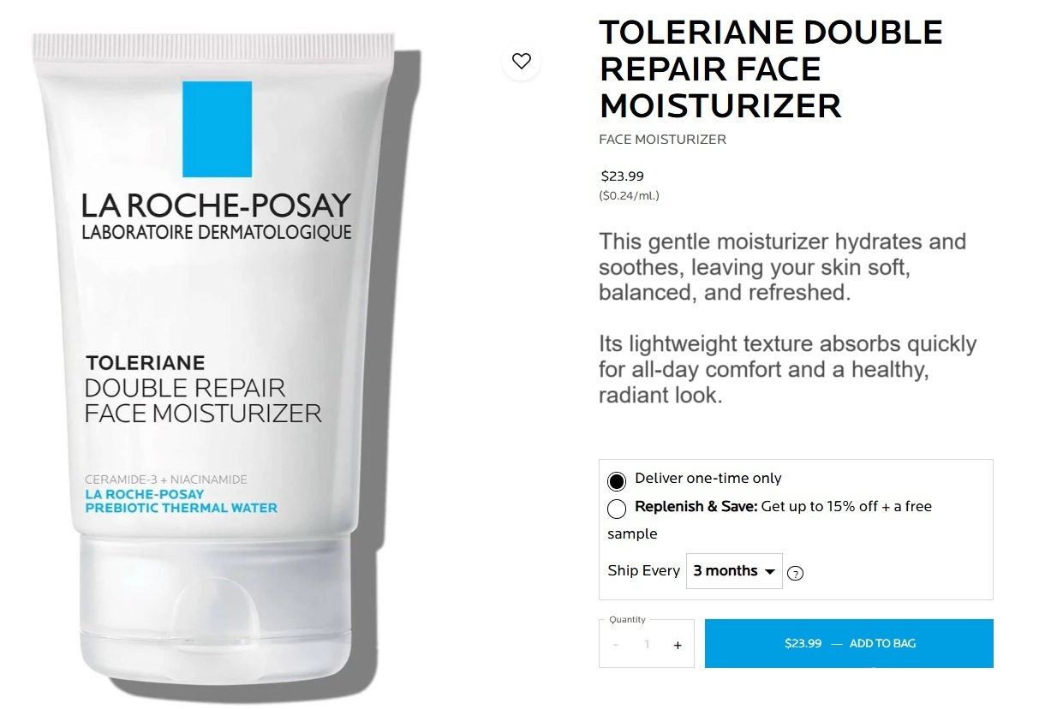
Control View

Slide 5
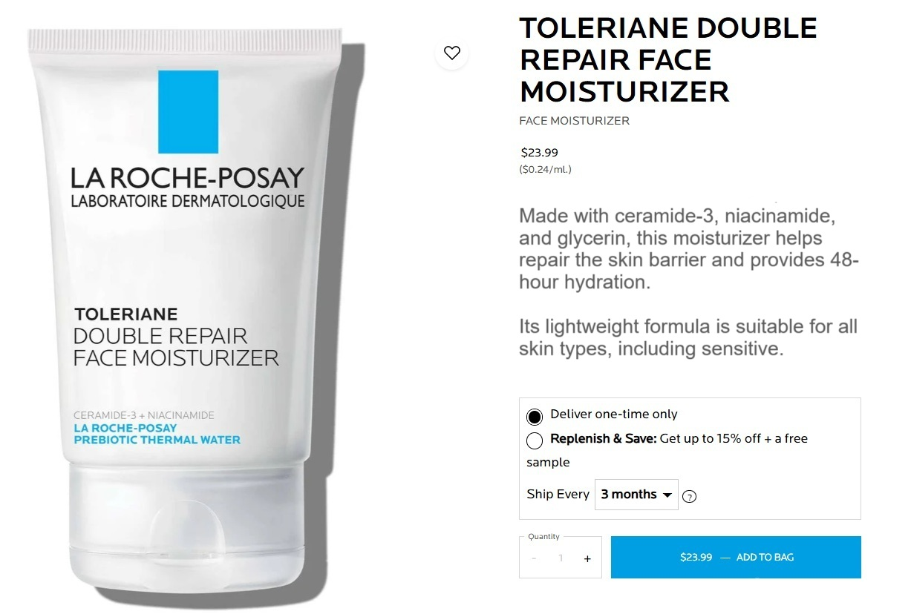
Treatment View

Slide 6
Control
Treatment
This gentle moisturizer hydrates and soothes, leaving your skin soft, balanced, and refreshed.
Its lightweight texture absorbs quickly for all-day comfort and a healthy, radiant look.
Made with ceramide-3, niacinamide, and glycerin, this moisturizer helps repair the skin barrier and provides 48-hour hydration.
Its lightweight formula is suitable for all skin types, including sensitive.

Slide 7
Pre-Survey Data
Age Group
Gender
Frequency of skincare usage
Level of skin care knowledge
Importance of ingredients in skincare

Slide 8
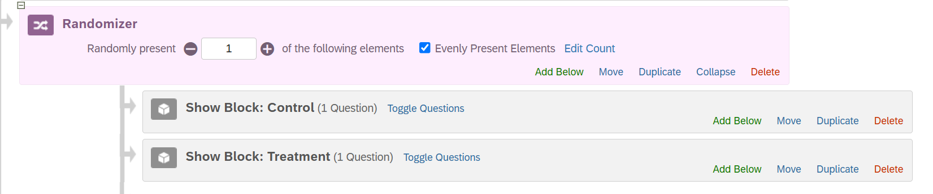
Randomization

Slide 9
Outcome Variables of Interest
On a 1–5 Likert Scale
I would consider purchasing this product. (Purchase Intent)
The description makes me confident in the quality of the product. (Perceived Trust)
The product seems effective based on the description. (Perceived Effectiveness)
I believe this product would deliver noticeable results. (Perceived Effectiveness)
The description made me feel good about the idea of using the product. (Emotional Appeal)

Slide 10
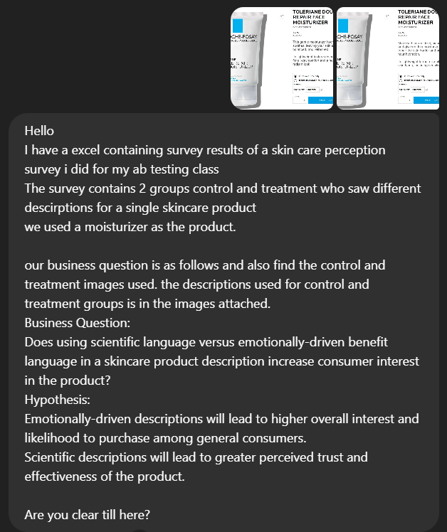
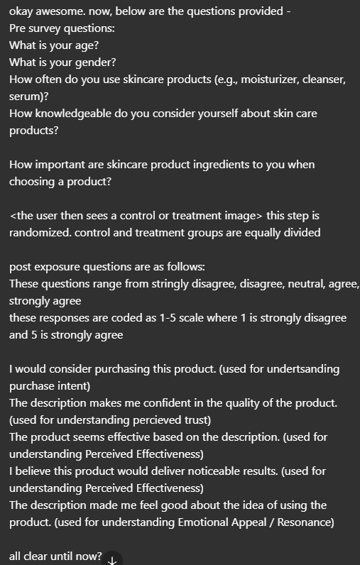
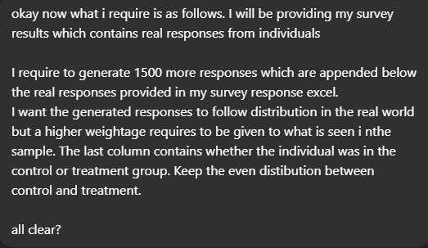

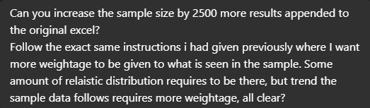
LLM Prompts

Slide 11
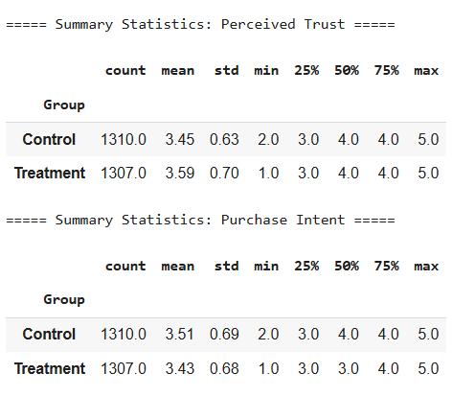
Summary Statistics

Slide 12
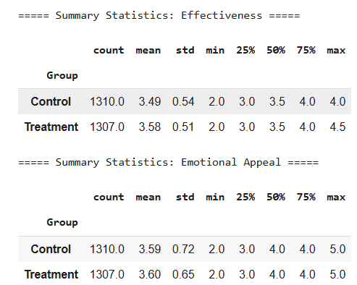
Summary Statistics

Slide 13
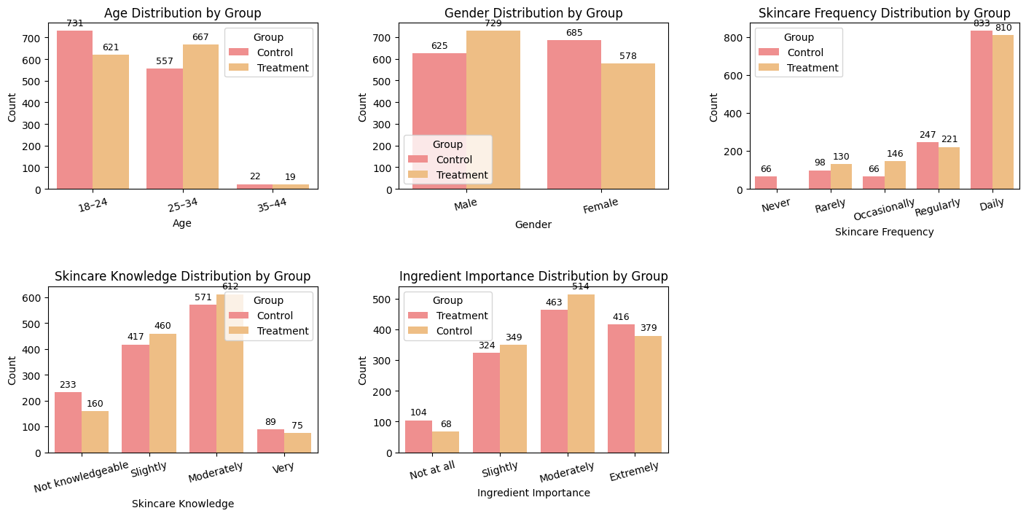
Data Analysis - Balance Check

Slide 14
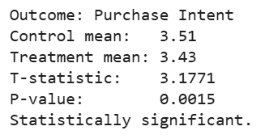
T-Test | Purchase Intent
Participants exposed to the emotionally-driven description showed significantly higher purchase intent than those who viewed the scientific version.

Slide 15
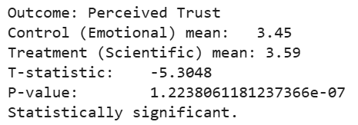
T-Test | Perceived Trust
Participants exposed to the scientific description reported significantly greater trust in the product compared to those who saw the emotional version.

Slide 16
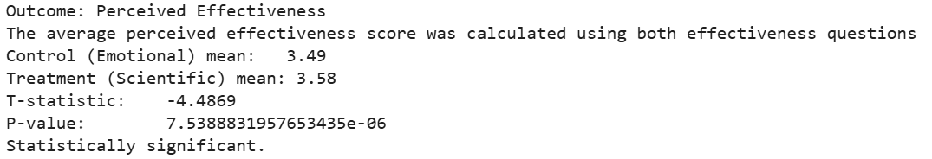
T-Test | Perceived Effectiveness
The scientific description led to significantly higher perceived effectiveness than the emotionally-driven version.

Slide 17
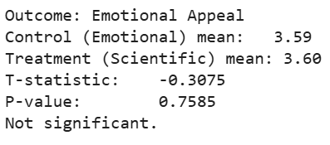
T-Test | Emotional Appeal
There was no significant difference in emotional appeal between the emotional and scientific descriptions.

Slide 18
Average Treatment Effects
For Full Sample Data:
Purchase Intent | -0.08
Perceived Trust | 0.14
Perceived Effectiveness | 0.09
Emotional Appeal | 0.01

Slide 19
Average Treatment Effects
For Human Responses (117 responses) :
Purchase Intent | -0.08
Perceived Trust | 0.13
Perceived Effectiveness | 0.11
Emotional Appeal | 0.01

Slide 20
Average Treatment Effects
For LLM Data (2500 responses) :
Purchase Intent | -0.08
Perceived Trust | 0.14
Perceived Effectiveness | 0.09
Emotional Appeal | 0.01

Slide 21
Heterogeneous Treatment Effects
Gender Focused Tests
 | Male | Female | Interpretation
Purchase Intent | -1.414 | -1.722 | Neither subgroup shows a statistically significant difference in Purchase Intent
Perceived Trust | -0.496 | 8.952 | For males, the treatment shows no effect but for females, the treatment yields a meaningful boost in Purchase Intent at the 5% significance level.

Slide 22
Heterogeneous Treatment Effects
Gender Focused Tests
 | Male | Female | Interpretation
Perceived Effectiveness | 1.233 | 6.410 | For males, the treatment shows no effect but for females, the treatment yields a meaningful boost in Purchase Intent at the 5% significance level.
Emotional Appeal | -3.827 | 5.164 | For males and females, the treatment yields a meaningful boost in Purchase Intent at the 5% significance level.

Slide 23
Heterogeneous Treatment Effects
Age Focused Tests
 | Age 18-24 | Age 25-34 | Interpretation
Purchase Intent | -3.073 | -0.951 | Only the 18–24 group exhibits a significant (negative) effect; the 25–34 group shows no statistically meaningful difference.
Perceived Trust | 3.510 | 3.074 | Both cohorts show strong, statistically significant positive effects, with the 18–24 group exhibiting a slightly larger t‑value (stronger signal) than the 25–34 group.

Slide 24
Heterogeneous Treatment Effects
Age Focused Tests
 | Age 18-24 | Age 25-34 | Interpretation
Perceived Effectiveness | 2.720 | 3.381 | Both age groups demonstrate statistically significant results, with the 25–34 cohort exhibiting a stronger effect (higher t, lower p) than the 18–24 cohort.
Emotional Appeal | 1.423 | -0.848 | Neither age group shows a statistically significant result—both p‑values are too large to conclude any real effect.

Slide 25
Power Calculations
An estimated power of 0.876 indicates an 87.6 % chance of detecting a true difference (at α = 0.05) between Treatment and Control on Purchase Intent.
A Cohen’s d of 0.1247 indicates that the difference in Purchase Intent between Control and Treatment is about 0.12 pooled standard deviations. Such a small effect is unlikely to matter to real users, even if it became “statistically significant” with a very large sample.

Slide 26
Results and Interpretation
The emotional description led to higher purchase intent, suggesting it may be more persuasive for driving consumer action. In contrast, the scientific description significantly improved perceived trust and effectiveness, indicating it is more effective for building credibility.
Emotional appeal did not differ between groups, suggesting scientific language can also create emotional connection when well-crafted.
Each style has its strengths:
Use emotional language to boost purchase intent.
Use scientific language to build trust and highlight effectiveness.

Slide 27
Limitations
Generalizability of Findings: The sample may be biased towards individuals already engaged with skincare. Those unfamiliar or indifferent to skincare routines may react differently to product descriptions, limiting external validity.
Comprehension of Descriptions: We cannot verify whether participants fully read or understood the product descriptions, raising uncertainty over whether the treatment was truly received. → Future studies could include brief comprehension checks to ensure participants engage with the content.
Low Statistical Power: The human sample (n = 117) yielded a low estimated power (9.3%) for detecting differences in purchase intent, meaning there is a high risk of Type II error. → Larger sample sizes would be required to draw more conclusive insights.
Confounding Variables: Factors like brand loyalty, familiarity with ingredients (e.g., ceramides), or personal skincare needs may have influenced outcomes. These variables were not fully controlled for. → Future surveys could collect additional data on prior brand use or specific skin concerns.
Limited Emotional Differentiation: Despite using emotionally-driven vs. scientific language, emotional appeal scores showed no significant difference, possibly indicating overlap in perceived tone. → Pre-testing the language with sentiment analysis tools could help better distinguish emotional vs. scientific framing.

